Slide 1
In this section, we will discuss:
Functions of Network Interface Card (NIC)
Repeaters
Hub
Switches

Slide 2
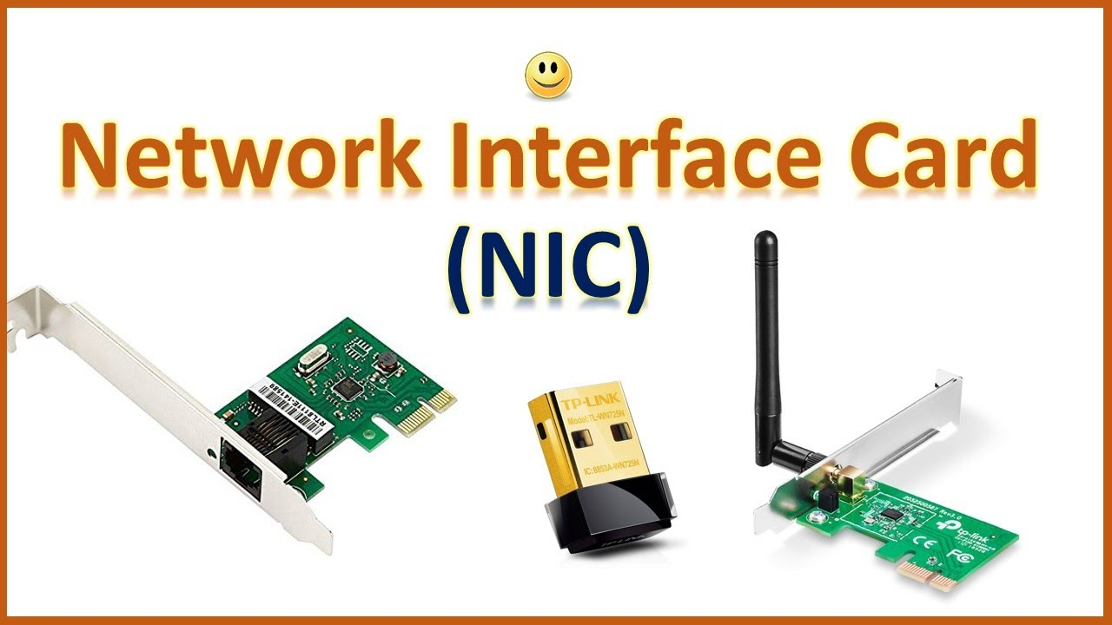
What is a Network Interface Card?
A network interface card (NIC) is a hardware component without which a computer can be connected over a network.
It is also called Ethernet Card, interface controller, Lan Adapter or Network Adapter.

Slide 3
Components of NIC
An external Memory is used to store the data temporarily and uses the stored data whenever required while processing the communication.
Connectors are used to make the physical link between cables and plugin with the board, this type of connection is especially seen in Ethernet type of NIC cables
MAC address which is a unique identity address is given to network interface card where ethernet packets are communicated with the computer.
MAC address is also known as a physical network address.

Slide 4
Type Of NIC Card
USB
Wireless
Wired

Slide 5
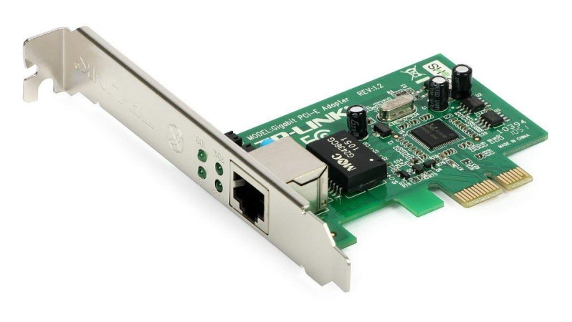
Wired NIC Card
These NIC have input jacks made of cables(Ethernet Cable).
The motherboard has a slot for the network cards where they are inserted.
The most widely used LAN technology is Ethernet.
Ethernet-based NIC is available in hardware shops.
The speed of Ethernet-based NIC can be 10/100/1000 Mbps.

Slide 6
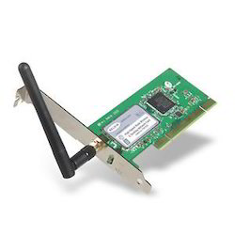
Wireless NIC Card
Wireless network cards are inserted into the motherboard but no network cables are required to connect the computer to designed for Wi-Fi the internet.
These NICs are connections.

Slide 7
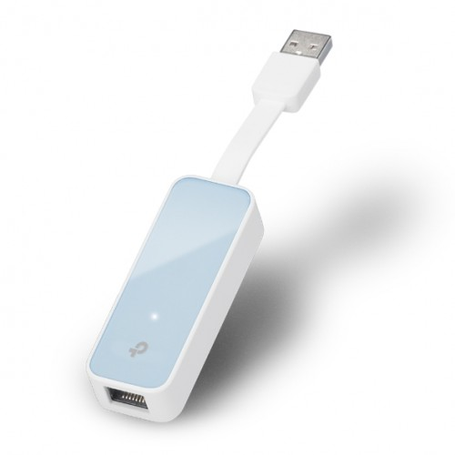
USB NIC Card
These are NICs that provide network connection over the device plugged in the USB port.

Slide 8
Advantages and Disadvantages of NIC
Advantages of NIC
Disadvantages of NIC
The communication speed using the Internet is high usually in Gigabytes.
Highly reliable connection
Many peripheral devices can be connected using many ports of NIC cards.
Bulk data can be shared among many users.
Inconvenient in case of wired cable NIC, as it is not portable like a wireless router
The configuration should be proper for better communication.
Data is unsecured.

Slide 9
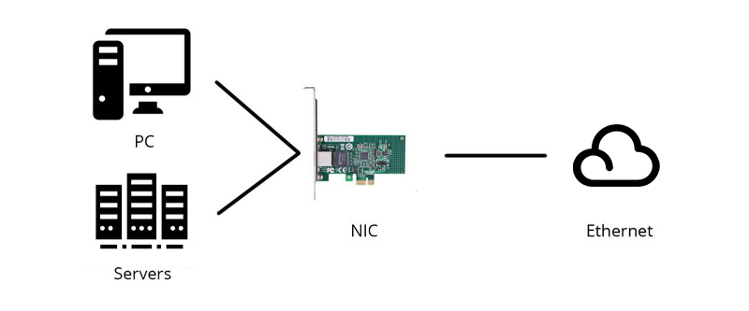
Functions of Network Interface Card
It is an electronic device that joins a computer to a computer network, usually a LAN.
The NIC contains the electronic circuitry required to connect using a wired connection (e.g., Ethernet) or a wireless connection (e.g., WiFi).

Slide 10
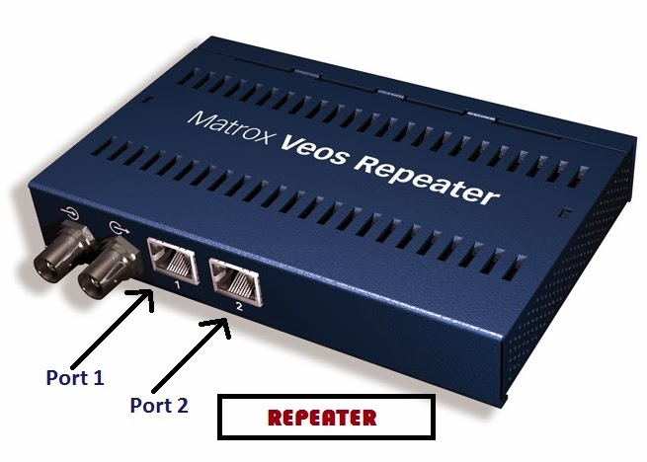
Repeaters
What is Repeaters?
Repeaters receive network signals on one port, amplify them, and repeat them out the other port.
Since they operate only at the Physical layer of the OSI model, repeaters can intersect different media types but cannot convert protocols.
The purpose of a repeater is to extend the maximum distance of a single network segment.

Slide 11
Advantages Disadvantages of Repeaters
Advantages of Repeaters
Disadvantages if Repeaters
It is used to regenerate the weak singnal
It is cheaper than other network device.
Repeater has the ability to extand the langht of singnal.
Increase and mentain the signal
It required number of repeater after same distance.
Repeaters also unable to connect dis-similar type of network
They can’t reduse single

Slide 12
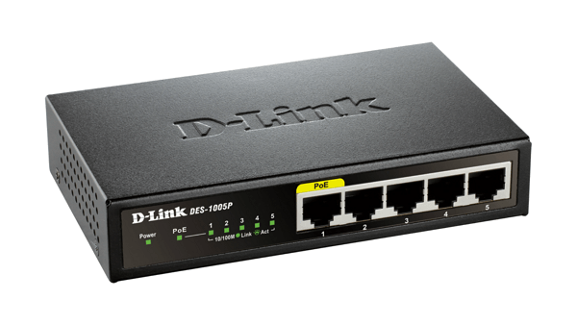
Hub
What is HUB?
A hub (also called a concentrator) serves as a central joining point for several network devices.
At a basic level, a hub is nothing more than a multiport repeater.
A hub repeats what it obtains on one port to all other ports.

Slide 13
Type Of Hub
Active Hub
Passive Hub
Intelligent Hub

Slide 14
Active Hub
It is usually powered and amplifies and cleans up the signal it receives, thus doubling the effective segment distance limitation for the specific topology.

Slide 15
Passive Hub
Typically it is unpowered and makes only physical, electrical connections. Usually, the maximum segment distance of a topology is shortened because the hub takes some power away from the signal strength in order to do its job.

Slide 16
Intelligent Hub
When compared with active and passive hubs, intelligent hubs have more benefits.
People who desire to extend businesses in networking might allocate users to use the same pool in an effective way through these hubs.

Slide 17
Advantages and Disadvantages of HUB
Advantages of HUB
Disadvantages of HUB
The hub can broadcast the msg.
IT is less expensive that anyone can use it.
Easy installation.
Robust.
If the hub is failed the intire network will be failed.
We can’t send private/personal data security.
Hub doesn’t provide any security.
Hub can’t support full duplex transmission mode.

Slide 18
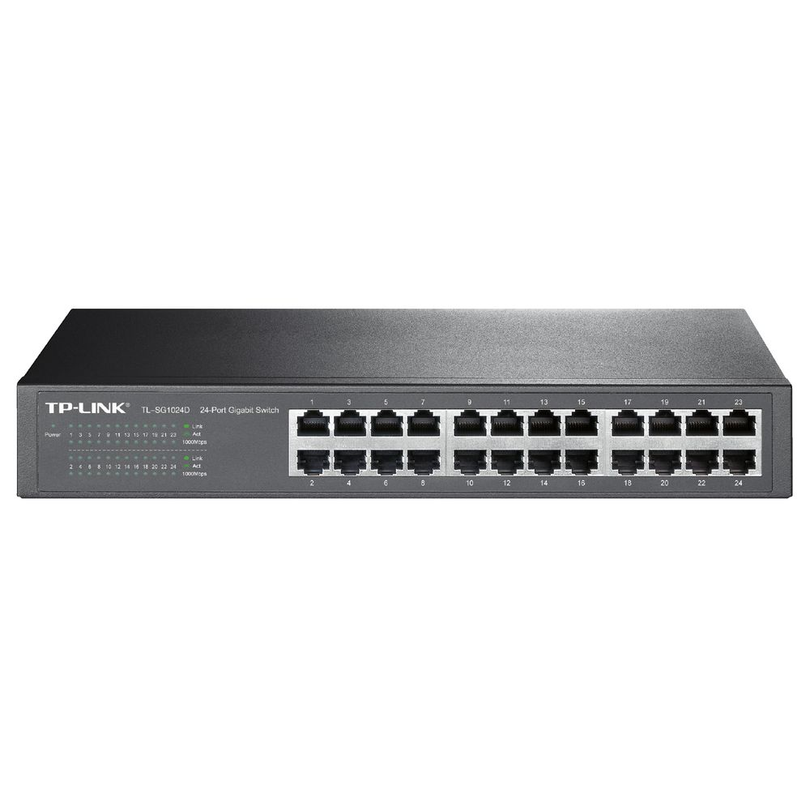
Switches
What is Switches?
Switches are key building blocks for any network.
They can connect multiple devices such as computers , printers , access points & servers etc. on same network within a building or campus

Slide 19
Role of switches in networking
Switching in a computer network is achieved by using switches.
Network switches operates at layer 2 (Data Link Layer) in the OSI Model.
It is operated in a full duplex mode.

Slide 20
Type Of Switches
Unmanaged Switches
POE Switch
LAN
Switch
Managed Switch

Slide 21
Unmanaged Switches
These are the switches that are used in home networks and small businesses.
They do not need to be configured as they work on home /small networks .
They require small cabling and they are least expensive too.

Slide 22
Managed Switches
These are the switches used in large organizations containing a large network.
These are costly but their scalability makes them an ideal option for a network that is going.
They are achieved by setting a simple network management protocol(SNMP)

Slide 23
LAN Switches
These are also known as Ethernet switches or Data switches.
They are used to reduce network congestion or bottleneck by distributing a package of data only to its intended recipient.

Slide 24
Power over Switches
POE switches are used in POE technology which stands for Power over Ethernet.
Technology that integrate data and power on the same cable allowing power devices to receive data in parallel to power

Slide 25
Advantages Disadvantages of switching
Advantages of switching
Disadvantages of switching
Increases the bandwidth of the network.
Reduces the workload of individual PC as it sends the information to only that device which has been addressed.
Increases the overall performance of the network by reducing the traffic on the network.
It is expensive as compared to network bridges.
It cannot determine the network connectivity issues easily.
While limiting broadcasts, they are not as good as routers.

Slide 26
Thank You 😊

